Slide 1
INTERNAL INTERNSHIP · 25ISE146
Smart Timetable
Possibility & Optimization Engine
Turning academic scheduling into a solved constraint-satisfaction problem — conflict-free timetables generated, scored, and ranked automatically.
Anvith A Gowda · Kriti P Desai · Tanmayi KT · Tejas Gowda M
Department of Information Science & Engineering · B.N.M. Institute of Technology, Bengaluru · 2025–26

Slide 2
01 · THE CHALLENGE
Problem Statement
Every academic term, administrators must place a large number of subjects, faculty members, student batches, and classrooms into a fixed weekly grid — without a single double-booking, and without shortchanging any batch's required contact hours.
5+
competing constraint types to satisfy simultaneously
Design and build a system that, given subjects, faculty, rooms, batches, and time slots, automatically generates one or more conflict-free timetables — enforcing hard constraints absolutely, while optimizing workload balance, idle gaps, and preferred slots as soft constraints. The result must be exportable and administrator-editable.
Days
typically lost to manual, trial-and-error scheduling
1
double-booking is enough to break an entire timetable
Chapter 1 · Introduction
Smart Timetable Possibility & Optimization Engine
1

Slide 3
01 · THE CHALLENGE
Objectives
🧩
Data Modelling
🔒
Guaranteed Feasibility
Represent subjects, faculty, rooms, batches and time slots, plus every constraint linking them.
A constraint-satisfaction engine that guarantees a hard-constraint-free, clash-free timetable.
📈
Quality Optimization
🖥️
Administrator UX
A genetic-algorithm / heuristic scoring layer that improves soft-constraint quality — workload balance, gap minimisation.
An intuitive interface to input institutional data and trigger generation with a single action.
🔀
Ranked Alternatives
📊
Scalable & Resilient
Generate multiple candidate timetables so administrators can compare and choose the best fit.
A backend that scales to institution-size datasets, with robust diagnostics when no valid timetable exists.
Chapter 1 · Introduction
Smart Timetable Possibility & Optimization Engine
2

Slide 4
01 · THE CHALLENGE
Scope of the Project
🧩
Automated Generation
🔒
Core Entities
Automatically builds complete weekly timetables from institutional input data with a single click.
Handles groups, teachers, subjects, rooms and all linking constraints in a unified model.
📈
Conflict-free Schedules
🖥️
Optimized Alternatives
Enforces hard constraints so no faculty, room or batch is double-booked in any slot.
Generates and ranks multiple candidate timetables scored on gaps, workload and preferences.
🔀
Export & Control
📊
End-to-end Pipeline
Supports CSV / print export and gives administrators full control over data and final selection.
From data entry through CSP solving, genetic optimisation and dashboard visualisation.
Chapter 1 · Introduction
Smart Timetable Possibility & Optimization Engine
3

Slide 5
02 · SYSTEM DESIGN
Existing vs Proposed System
EXISTING SYSTEM
PROPOSED SYSTEM
Manual Timetabling
Smart Timetable Engine
✕
Built by hand, often in spreadsheets — days of trial-and-error per term
✓
CSP + backtracking guarantees a clash-free schedule, seeded by graph colouring
✕
High risk of double-booked faculty, rooms or batches
✓
Genetic algorithm optimizes soft constraints — gaps, workload, preferences
✕
No systematic optimisation of workload or idle gaps
✓
Generates several ranked, scored alternative timetables
✕
Produces a single rigid schedule that is hard to revise
✓
Single-click generation from a structured web dashboard
✕
Scales poorly beyond a handful of batches
✓
Feasibility diagnostics flag unsolvable constraint sets instantly
Chapter 7 · System Design
Smart Timetable Possibility & Optimization Engine
3

Slide 6
02 · SYSTEM DESIGN
System Architecture
A layered architecture separating data storage, constraint solving, optimisation, and user interaction — each layer developed, tested and extended independently.
🖥️
Presentation Layer
HTML5 · CSS3 · JavaScript dashboard for data entry, single-click generation, and a colour-coded weekly grid view.
▼
🔗
Application / API Layer
Endpoints receive data-entry & generation requests, validate input, and dispatch jobs to the solver.
▼
🧠
Solver Layer
Constraint Builder → Graph-Colouring Seed Generator → Genetic Algorithm Optimizer.
▼
🗄️
Persistence Layer
MySQL relational storage for master data, constraints, generated timetables and audit history (via JDBC).
Chapter 4 · System Architecture
Smart Timetable Possibility & Optimization Engine
4

Slide 7
03 · SOLVER DESIGN
Constraints & Optimization
HARD CONSTRAINTS · non-negotiable
SOFT CONSTRAINTS · fitness-scored
Faculty uniqueness
Gap penalty
No two sessions of the same faculty share a time slot
Idle periods in a faculty member's daily schedule are penalised
Room uniqueness
Workload balance
No two sessions occupy the same room in the same slot
Variance in classes-per-day for each faculty is minimised
Batch uniqueness
Preference satisfaction
No two sessions of the same batch share a time slot
Assignments matching declared preferred slots earn a bonus
Hour completeness
Room utilisation
Every subject–batch pair receives its prescribed weekly hours
Under- or over-crowded rooms receive a mild penalty
Chapter 6 · Algorithm Design
Smart Timetable Possibility & Optimization Engine
5

Slide 8
03 · SOLVER DESIGN
Algorithm Flow
A hybrid pipeline: constructive seeding first guarantees feasibility, then a genetic algorithm refines quality.
1
2
3
4
5
6
Load Data
Build CSP Model
Graph-Colouring Seed
Genetic Algorithm
Fitness Evaluation
Rank & Output
→
→
→
→
→
Read subjects, faculty, rooms, batches from institutional input.
Variables = subject–batch–hour units; domains = feasible (slot, room) pairs.
DSATUR-style greedy colouring yields a fast, conflict-free starting timetable.
Tournament selection → constraint-preserving crossover → low-probability mutation.
Score against soft constraints; evolve until convergence or generation limit.
Diagnose infeasibility, or return the best-scoring, clash-free timetable(s).
Chapter 5–6 · Methodology & Algorithm Design
Smart Timetable Possibility & Optimization Engine
6

Slide 9
04 · IMPLEMENTATION
Frontend + Backend Communication
How the web dashboard and the Java optimization engine exchange data via JDBC and MySQL.
→
🖥️
⚙️
MySQL Database
Frontend
GROUPS · TEACHERS · SUBJECTS · ROOMS · SETTINGS
Java Optimization Engine
HTML5 · CSS3 · JavaScript dashboard
CSP + Genetic Algorithm (Java)
• Forms collect Groups, Teachers, Subjects, Rooms
Java + JDBC Driver
• Loads entities from MySQL via JDBC ResultSets
SQL INSERT / SELECT
• Data sent to Java backend via REST / form posts
• Builds valid solutions via constructive / CSP search
Generated Timetable
• JDBC layer inserts/updates records in MySQL
Rows: Group, Day, Period, Subject, Teacher, Room
• Scores on gaps, workload balance, room utilisation
• Timetable results retrieved from DB and rendered
• Persists top-ranked timetable(s) back to MySQL
←
Chapter 8 · Implementation
Smart Timetable Possibility & Optimization Engine
7

Slide 10
02 · SYSTEM DESIGN
Complete Data Flow
End-to-end path from user input to optimized timetable
User → HTML / CSS / JavaScript Frontend
↓
Java Application → JDBC → DAO Classes
↓
MySQL Database (groups, teachers, subjects, rooms)
↓
Timetable Data written to input.txt
↓
C++ Optimization Engine
• Constraint checking • Solution generation
• Scoring • Select best valid solution
↓
output.txt → Frontend Result Display
Note: JDBC = Java ↔ MySQL only
C++ uses file I/O (input.txt / output.txt)
Chapter 4 · System Architecture
Smart Timetable Possibility & Optimization Engine
25

Slide 11
04 · IMPLEMENTATION
JDBC & Database Integration
JDBC + MYSQL INTEGRATION
ARCHITECTURE FLOW
JDBC Connectivity
Frontend (HTML/CSS/JS)
JDBC connects the Java application with MySQL.
↓
Persistent Storage
Java + JDBC
Stores groups, teachers, subjects and rooms.
↓
Driver & Connection
MySQL Database
Java uses MySQL JDBC Driver to establish connection.
↓
SQL Data Access
Timetable Data / Optimization Engine
SQL queries insert, retrieve and manage all data.
Structured, persistent and scalable data layer.
Chapter 8 · Implementation
Smart Timetable Possibility & Optimization Engine
24

Slide 12
04 · IMPLEMENTATION
System Requirements
SOFTWARE REQUIREMENTS
HARDWARE REQUIREMENTS
Frontend Technologies
Computing Device
HTML5, CSS3 and JavaScript for the interactive dashboard, forms and timetable visualisation.
Desktop or laptop capable of running Java (JDK) and a local MySQL instance.
Backend / Solver
Memory
Java engine with JDBC; CSP constructive search and genetic-algorithm optimisation.
Minimum 8 GB RAM recommended (matches report hardware baseline).
Development Tools
Peripherals
VS Code / IntelliJ / Eclipse for frontend and Java source files.
Standard keyboard and mouse for data entry and dashboard interaction.
Runtime Environment
Connectivity
Any modern web browser (Chrome, Edge, Firefox); MySQL server for persistence.
Internet connection optional — required only if deploying online or fetching external resources.
Chapter 8 · Implementation
Smart Timetable Possibility & Optimization Engine
8

Slide 13
05 · SOURCE CODE
Key Implementation Highlights
Core algorithm, dashboard forms & styling — essential excerpts only
9

Slide 14
05 · SOURCE CODE
Algorithm · createSolution()
Core constructive search (Java / CSP engine) that builds a conflict-free timetable under hard constraints
bool createSolution(Solution &result) {
vector<Assignment> assignments;
vector<Subject> orderedSubjects = subjects;
sort(orderedSubjects.begin(), orderedSubjects.end(),
[](const Subject &a, const Subject &b) {
return a.count > b.count;
});
for (const auto &subject : orderedSubjects) {
for (int k = 0; k < subject.count; k++) {
for (int day = 0; day < workingDays; day++) {
for (int period = 1; period <= periodsPerDay; period++) {
if (!teacherAvailable(subject.teacher, day))
continue;
if (groupHasPeriod(assignments,
subject.group, day, period))
continue;
string room =
chooseRoom(subject, assignments, day, period);
if (room.empty())
continue;
Assignment x{subject, room, day, period};
if (!validAssignment(x, assignments))
continue;
assignments.push_back(x);
goto assigned;
}
}
return false;
assigned:;
}
}
if (!verifyPeriodCounts(assignments))
return false;
result = evaluate(assignments);
return true;
}
Chapter 5–8 · Implementation
Smart Timetable Possibility & Optimization Engine
10

Slide 15
05 · SOURCE CODE
HTML · Generate & Results Sections
Generate & Results sections used by the administrator UI
<section id="generate" class="section hidden">
<h2>Generate Timetable</h2>
<p>
Enter the required groups, teachers, subjects and rooms.
The system checks the constraints and generates an optimized timetable.
</p>
<button type="button" onclick="generateTimetable()">
Generate Timetable
</button>
<p id="searchProcess"></p>
</section>
<section id="results" class="section hidden">
<h2>Generated Timetable</h2>
<div id="timetableOutput"></div>
<div class="results-actions">
<button type="button" onclick="exportCSV()">Export CSV</button>
<button type="button" onclick="printTimetable()">Print Timetable</button>
</div>
<h2>Optimization Summary</h2>
<div id="optimizationSummary"></div>
<div id="scoreBreakdown"></div>
<h2>Teacher Workload</h2>
<div id="teacherWorkload"></div>
<h2>Room Utilization</h2>
<div id="roomUtilization"></div>
</section>
Chapter 5–8 · Implementation
Smart Timetable Possibility & Optimization Engine
11

Slide 16
05 · SOURCE CODE
Professional Timetable Grid Styles
Colour-coded weekly grid, class cards, badges and free-period styling
.professional-timetable {
width: 100%;
border-collapse: collapse;
background: white;
}
.professional-timetable th {
background: #344b77;
color: white;
padding: 15px;
text-align: center;
}
.timetable-cell {
height: 105px;
padding: 7px;
text-align: center;
border: 1px solid #d9dee7;
}
.class-card {
min-height: 85px;
display: flex;
flex-direction: column;
justify-content: center;
align-items: center;
padding: 8px;
border-radius: 8px;
background: #f4f7fc;
}
.subject-name {
font-size: 15px;
font-weight: bold;
color: #1f2a44;
}
.teacher-name {
font-size: 12px;
color: #4b5563;
margin: 6px;
}
.room-badge,
.group-badge {
font-size: 10px;
padding: 4px 7px;
border-radius: 4px;
}
.free-cell {
background: #fafafa;
}
.free-period {
color: #a0a7b2;
font-size: 12px;
font-weight: 600;
}
Chapter 5–8 · Implementation
Smart Timetable Possibility & Optimization Engine
12

Slide 17
05 · SOURCE CODE
JavaScript · generateTimetable()
Client-side constraint checking, slot assignment and optimisation summary
function generateTimetable() {
if (!validateInput()) return;
const days = Number(document.getElementById("workingDays").value);
const periods = Number(document.getElementById("periodsPerDay").value);
generatedTimetable = [];
let usedTeacherSlots = new Set();
let usedGroupSlots = new Set();
let usedRoomSlots = new Set();
subjects.forEach(subject => {
for (let i = 0; i < subject.periods; i++) {
for (let day = 0; day < days; day++) {
for (let period = 1; period <= periods; period++) {
const teacherKey = `${subject.teacher}_${day}_${period}`;
const groupKey = `${subject.group}_${day}_${period}`;
if (usedTeacherSlots.has(teacherKey) ||
usedGroupSlots.has(groupKey)) continue;
const room = rooms.find(r =>
!usedRoomSlots.has(`${r.name}_${day}_${period}`) &&
r.capacity >= getGroupSize(subject.group) &&
r.type.toLowerCase() === subject.roomType.toLowerCase()
);
if (!room) continue;
generatedTimetable.push({
subject: subject.name,
teacher: subject.teacher,
group: subject.group,
room: room.name,
day: getDayName(day),
period: period
});
usedTeacherSlots.add(teacherKey);
usedGroupSlots.add(groupKey);
usedRoomSlots.add(`${room.name}_${day}_${period}`);
break;
}
if (generatedTimetable.length >= subjects.reduce(
(sum, s) => sum + s.periods, 0)) break;
}
}
});
displayTimetable();
calculateOptimization();
showSection("results");
}
Chapter 5–8 · Implementation
Smart Timetable Possibility & Optimization Engine
13

Slide 18
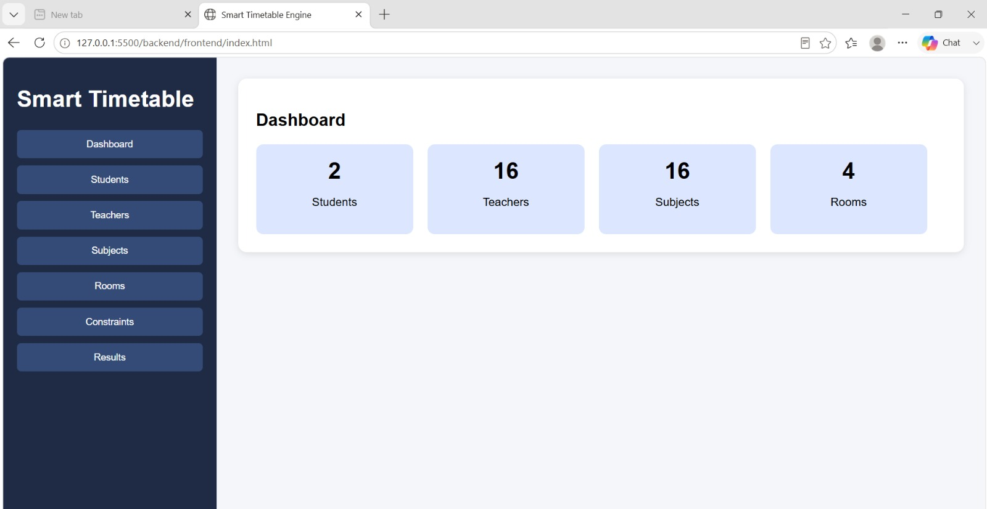
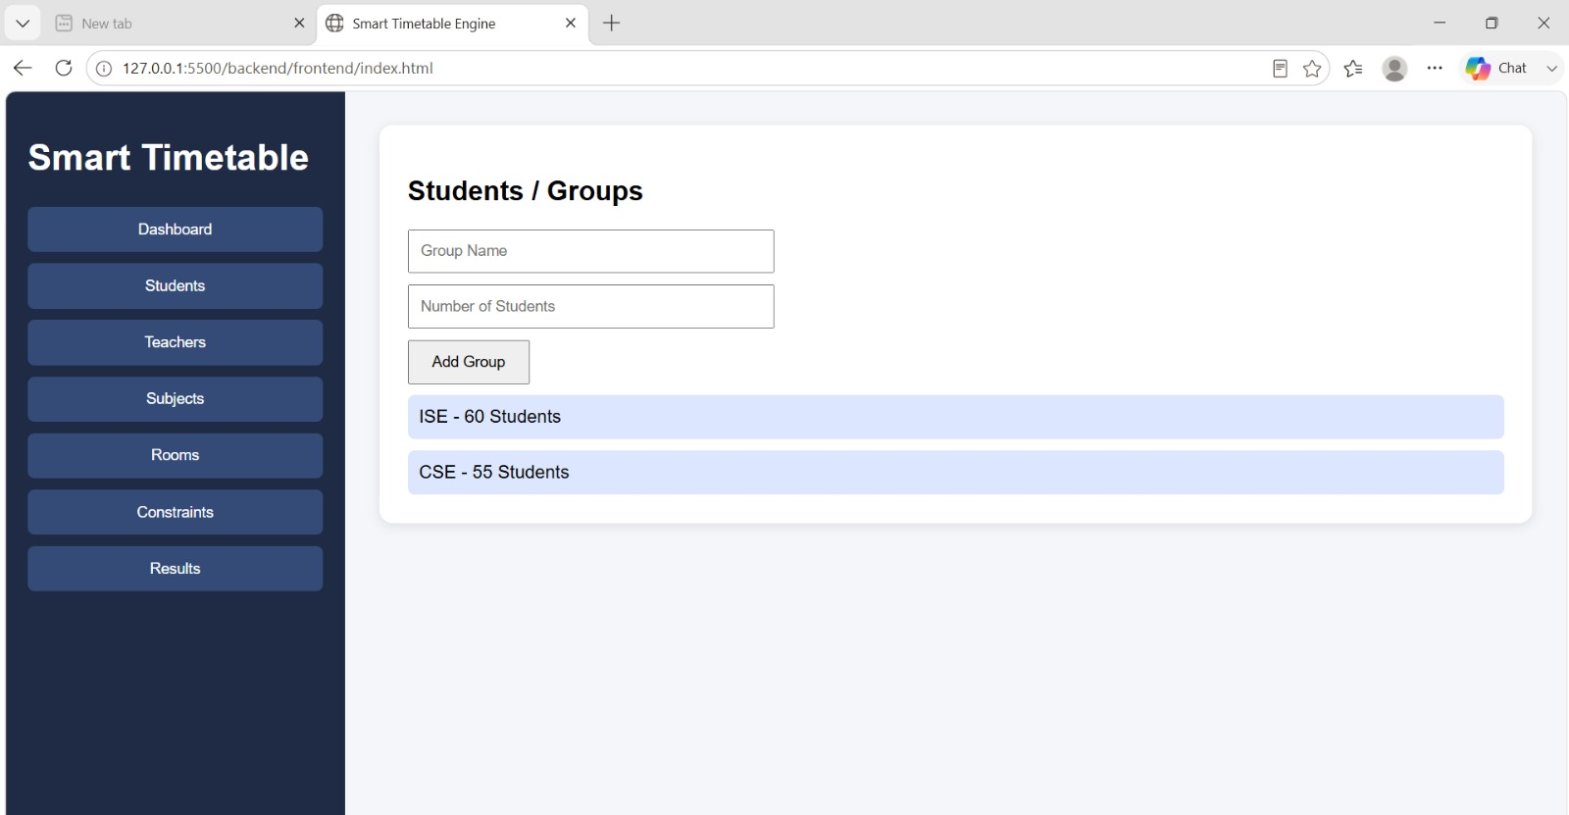
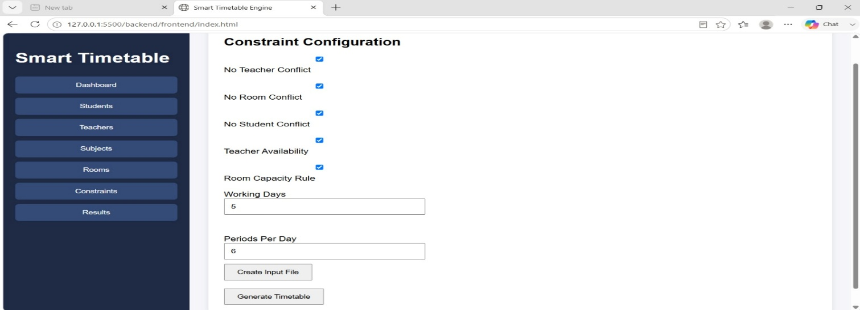
06 · RESULTS
Results — Data Entry & Configuration
Live Dashboard
Student / Group Management
Constraint Configuration
Chapter 9 · Results
Smart Timetable Possibility & Optimization Engine
50

Slide 19
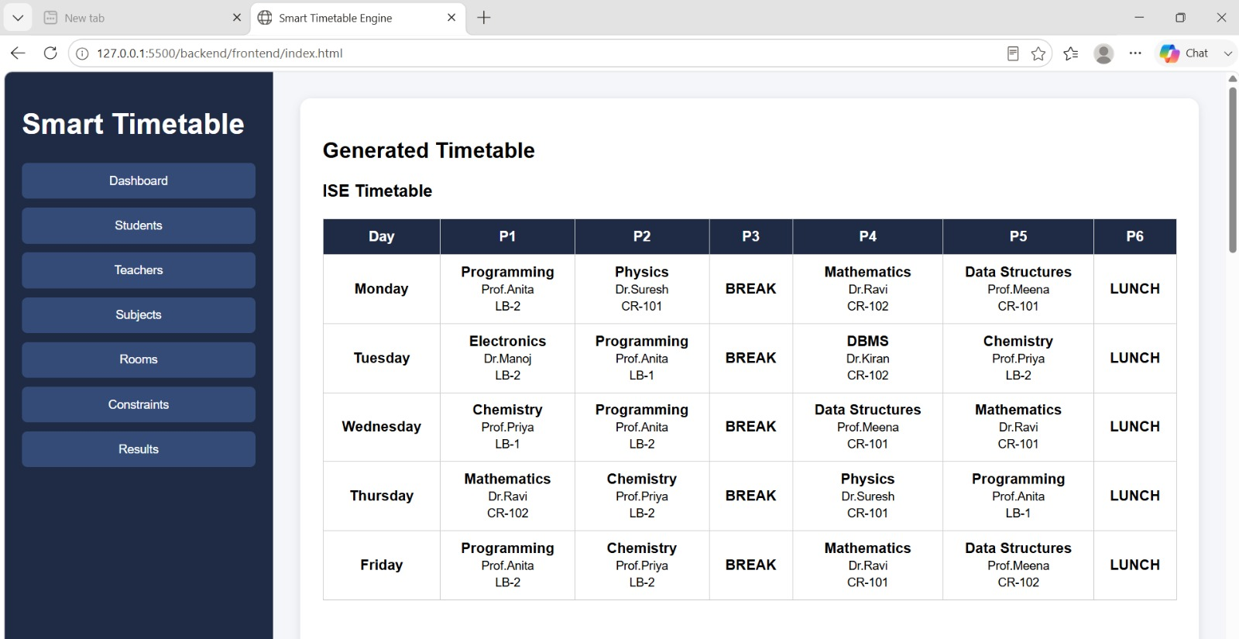
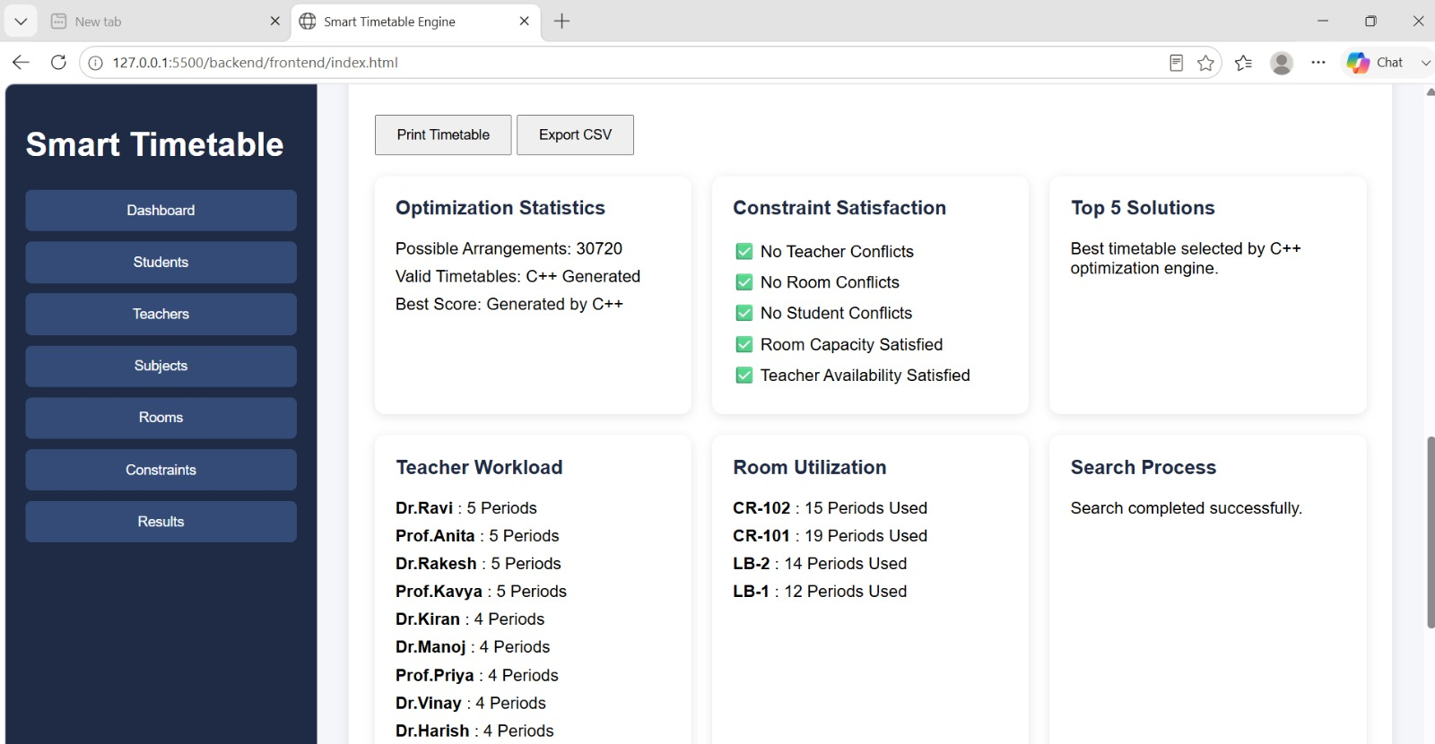
06 · RESULTS
Results — Generated Timetable & Optimization
Weekly Grid — Conflict-free, Colour-coded
Optimization Stats & Workload
Chapter 9 · Results
Smart Timetable Possibility & Optimization Engine
51

Slide 20
06 · RESULTS
What the Testing Showed
100%
Seconds→Min
2–3
PDF / Excel
Constraint satisfaction — zero double-bookings across every test run
Feasible seed in seconds; near-optimal solution within minutes
Top-ranked alternative timetables reviewed per generation run
Export formats supported straight from the dashboard
Across successive GA generations, fitness improved steadily — idle faculty gaps shrank and daily workload spread more evenly than the initial graph-coloured seed.
Chapter 9 · Results
Smart Timetable Possibility & Optimization Engine
52

Slide 21
07 · WRAP-UP
Conclusion & Future Scope
CONCLUSION
FUTURE SCOPE
Classical constraint satisfaction, combined with evolutionary optimisation, automates a complex recurring administrative task. Modelling timetabling as a CSP with a multi-objective fitness layer reliably produces fully conflict-free schedules while improving gap minimisation and workload balance. The graph-colouring seed + genetic algorithm pipeline delivers high-quality results within practical time limits, and a web dashboard with clear feasibility diagnostics makes it usable by non-technical staff.
▸
Real-time Rescheduling Re-optimise only the affected slice on sudden faculty leave or room loss
▸
Multi-campus Scheduling Shared resources & travel-time constraints across departments
▸
Elective / CBCS Support Native clash detection across heterogeneous student groups
▸
Faculty Preference Learning ML models that learn preferences over successive semesters
▸
ERP / LMS Integration Bi-directional sync with student-information & attendance systems
▸
NSGA-II Multi-objective A true Pareto front of trade-off timetables instead of a weighted sum
Chapter 10–11 · Future Scope & Conclusion
Smart Timetable Possibility & Optimization Engine
53

Slide 22
08 · REFERENCES
References
KEY LITERATURE & DOCUMENTATION
SELECTED REFERENCES
Sources span classic CSP / GA timetabling surveys plus official language and web documentation used in implementation (Java, JDBC, MySQL, HTML5, CSS3, JavaScript).
▸
Java / JDBCOracle JDBC & MySQL Connector/J documentation for database connectivity.
▸
MDN Web DocsHTML5, CSS3, JavaScript and Fetch API documentation (Mozilla Developer Network).
▸
Burke & PetrovicRecent research directions in automated timetabling. EJOR, 2002.
▸
Schaerf / LewisSurveys of automated & metaheuristic university/school timetabling (AI Review, OR Spectrum).
▸
Pillay / MirHassaniSchool & course timetabling solution approaches (Annals of OR, AI Review).
▸
Bettinelli et al. An overview of curriculum-based course timetabling. TOP, 2015.
Chapter 12 · References
Smart Timetable Possibility & Optimization Engine
54

Slide 23
08 · SDG MAPPING
Sustainable Development Goals Alignment
PRIMARY · SDG 4 Quality Education
HOW THE SYSTEM CONTRIBUTES
SDG 4 — Quality Education
Conflict-free schedules
Supports better academic planning by generating organised, conflict-free timetables that maximise instructional contact hours.
Eliminates double-bookings so every batch receives full prescribed contact hours.
SDG 9 — Industry, Innovation & Infrastructure
Workload balance
Applies automation, CSP modelling and evolutionary optimisation to a traditionally manual administrative process.
Genetic algorithm reduces variance in faculty daily load, supporting staff wellbeing.
SDG 12 — Responsible Consumption & Production
Resource efficiency
Promotes efficient utilisation of classrooms, faculty time and other academic resources, reducing idle capacity.
Room utilisation scoring discourages under- and over-crowding of classrooms.
Impact Summary
Scalable automation
Primary alignment is with SDG 4; secondary contributions to innovation (SDG 9) and resource efficiency (SDG 12).
Single-click generation replaces days of manual trial-and-error scheduling.
Chapter 12 · SDG Mapping
Smart Timetable Possibility & Optimization Engine
55

Slide 24
Thank You
Questions & Discussion
Anvith A Gowda · Kriti P Desai · Tanmayi KT · Tejas Gowda M
Department of Information Science & Engineering · B.N.M. Institute of Technology, Bengaluru

